Slide 1
DETECTION the possibility OF BRAIN TUMOR USING iOT
SUPERVISED BY
DR. AHMED WASIF REZA
ASSOCIATE PROFESSOR
DEPARTMENT OF CSE
PRESENTED BY
IFRAT JAHAN ( 2014-2-60-051)
MD LIZUR RAHMAN (2014-3-60-014)

Slide 2
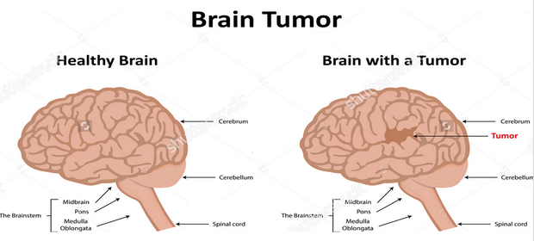
BACKGROUND
https://www.google.com/search?q=BRAIN+TUMOR&rlz=1C1CHBD_enBD790BD790&source=lnms&tbm=isch&sa=X&ved=0ahUKEwi7iszGnLzaAhWIKo8KHXZgDjEQ_AUICigB&biw=1366&bih=662#imgrc=hyAF4-NTf3wf7M:

Slide 3
BACKGROUND
Key term | Summary
Brain Tumor | Large amount of abnormal cell combine together and causes brain tumor in our body
Benign Brain Tumor | It’s a part of a brain tumor and also known as Non-cancerous brain tumor
Malignant Brain Tumor | It’s a part of a brain tumor and also known as a cancerous brain tumor
Primary Brain Tumor | It’s a part of a cancerous brain tumor and begins in brain
Secondary Brain Tumor | It’s a part of a cancerous brain tumor. Its begins in the other parts of the body and spread through the brain
Risk Factors of Brain Tumor | Age , Exposure to radiation, Chemical exposure, Family history, Gender, Head injury, Seizures etc.
Symptoms of Brain Tumor | Headache, Vomiting or nausea, Vision changes, Seizures, Walking problem, drowsiness or sleeping problem, fatigue.
3

Slide 4
Literature Review
Reference | Algorithm used | Existing Techniques
Islam et. Al [1] | MRI Segmentation, Naïve Bayes Classifier | Individualizing the texture of Tumor in Brain MRIs
G.Singh [2] | K-Means algorithm, Normalized Histogram Segmentation, SVM | Efficient Detection of Brain Tumor
Rao et. al [3] | Conditional Random field in MRI images, Modified MRF method | Automatic detection and segmentation of brain tumor
B.Singh [4] | MRI images detection, Fuzzy filter to remove noise, | A Modified mean-shift based fuzzy c-mean segmentation technique
A.Halder [5] | SVM to classify MRI images | A SVM and rough K-means based brain tumor detection algorithm
S.K.Shil et.al [6] | Discrete wavelet transform technique, Principal component analysis technique, SVM | A technique to detect and classify of brain tumor
Samjith [7] | K-means clustering segmentation, HCSD method, KNN classifier | A technique to detect brain tumor tissue automatically
4

Slide 5
Problem Statement
Previous brain tumor detection techniques are very costly as they use MRI images.
Doctor detect the brain tumor which is a time consuming for which they feel burden.
Still there is no unique technique which can easily predict the probability of brain tumor in real time.
5

Slide 6
OBJECTIVES
The aim of our study is to detect the brain tumor using IoT. This technique does not require any X-ray MRI images because X-ray is costly and low classes of people does not have the capability. So our goal is to create a device which can solve these problem. Our main two objectives are-
To measure the probability of brain tumor
To create a device which will detect brain tumor within a low cost
6

Slide 7
Flow Chart of Proposed Method
Brain Tumor
Headache
High Blood Pressure
Increase Body Temperature
Drowsiness
Insomnia
Vomiting or Nausea
Seizures
Vomiting or Nausea
High Heart Rate
High Blood Pressure
Increase Body Temperature
Walking Problem
Fatigue
Vision Change
Low Heart Rate
High Blood Pressure
Headache
High Heart Rate
High Blood Pressure
Less Amount of Steps
Lack Coordination in the Arm or Legs
Less Amount of Deep Sleep
Insomnia
Headache
More Awake Time
Vision Change
Vomiting or Nausea
7

Slide 8
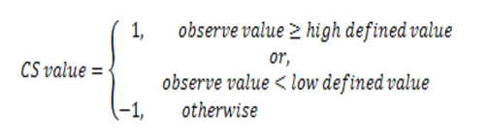
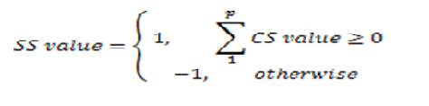
Equations of Proposed Method
CS | HDV | LDV
High Blood Pressure | 140 & 90
Increase Body Temperature | 98
High Heart rate | 101
Low Heart Rate |  | 60
Insomnia |  | 240
Less amount of Deep Sleep |  | 40
Less amount of Steps |  | Previous data
Lack Coordination in the arm or legs |  | Previous data
Large amount of Awake time in between Sleep | 35
. . . (1)
. . . . (2)
Where, p= total CS related to SS
Here, CS for Classification Symptoms and SS for Main Symptoms
8
HDV and LDV value for CS

Slide 9
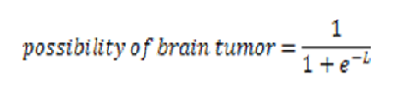
Equations of Proposed Method
CS | HDV | LDV
High Blood Pressure | 140 & 90
Increase Body Temperature | 98
High Heart rate | 101
Low Heart Rate |  | 60
Insomnia |  | 240
Less amount of Deep Sleep |  | 40
Less amount of Steps |  | Previous data
Lack Coordination in the arm or legs |  | Previous data
Large amount of Awake time in between Sleep | 35
. . . (3)
Where, L= sum of all SSs value (HA+VN+VC+SZ+WP+DS+FG)
9
HDV and LDV value for CS

Slide 10
Proposed Methodology Steps of Algorithm
Define the Symptoms & Classification Symptoms
Input Heart Rate & Body Temperature using Sensors
Calculate Classification Symptoms(CS) using Eqn. (1)
Calculate Main Symptoms(SS) using Eqn. (2)
Calculate the Probability of Brain Tumor
10

Slide 11
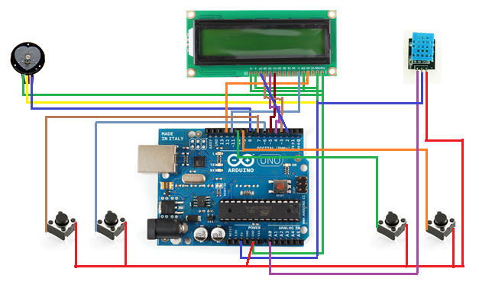
Experimental Scenario Drawing circuit diagram
Temperature Sensor
Pulse Sensor
Lack Coordination in the arm or leg
Less amount of Steps
Reset
Start
Circuit Diagram to detect Brain Tumor
11

Slide 12
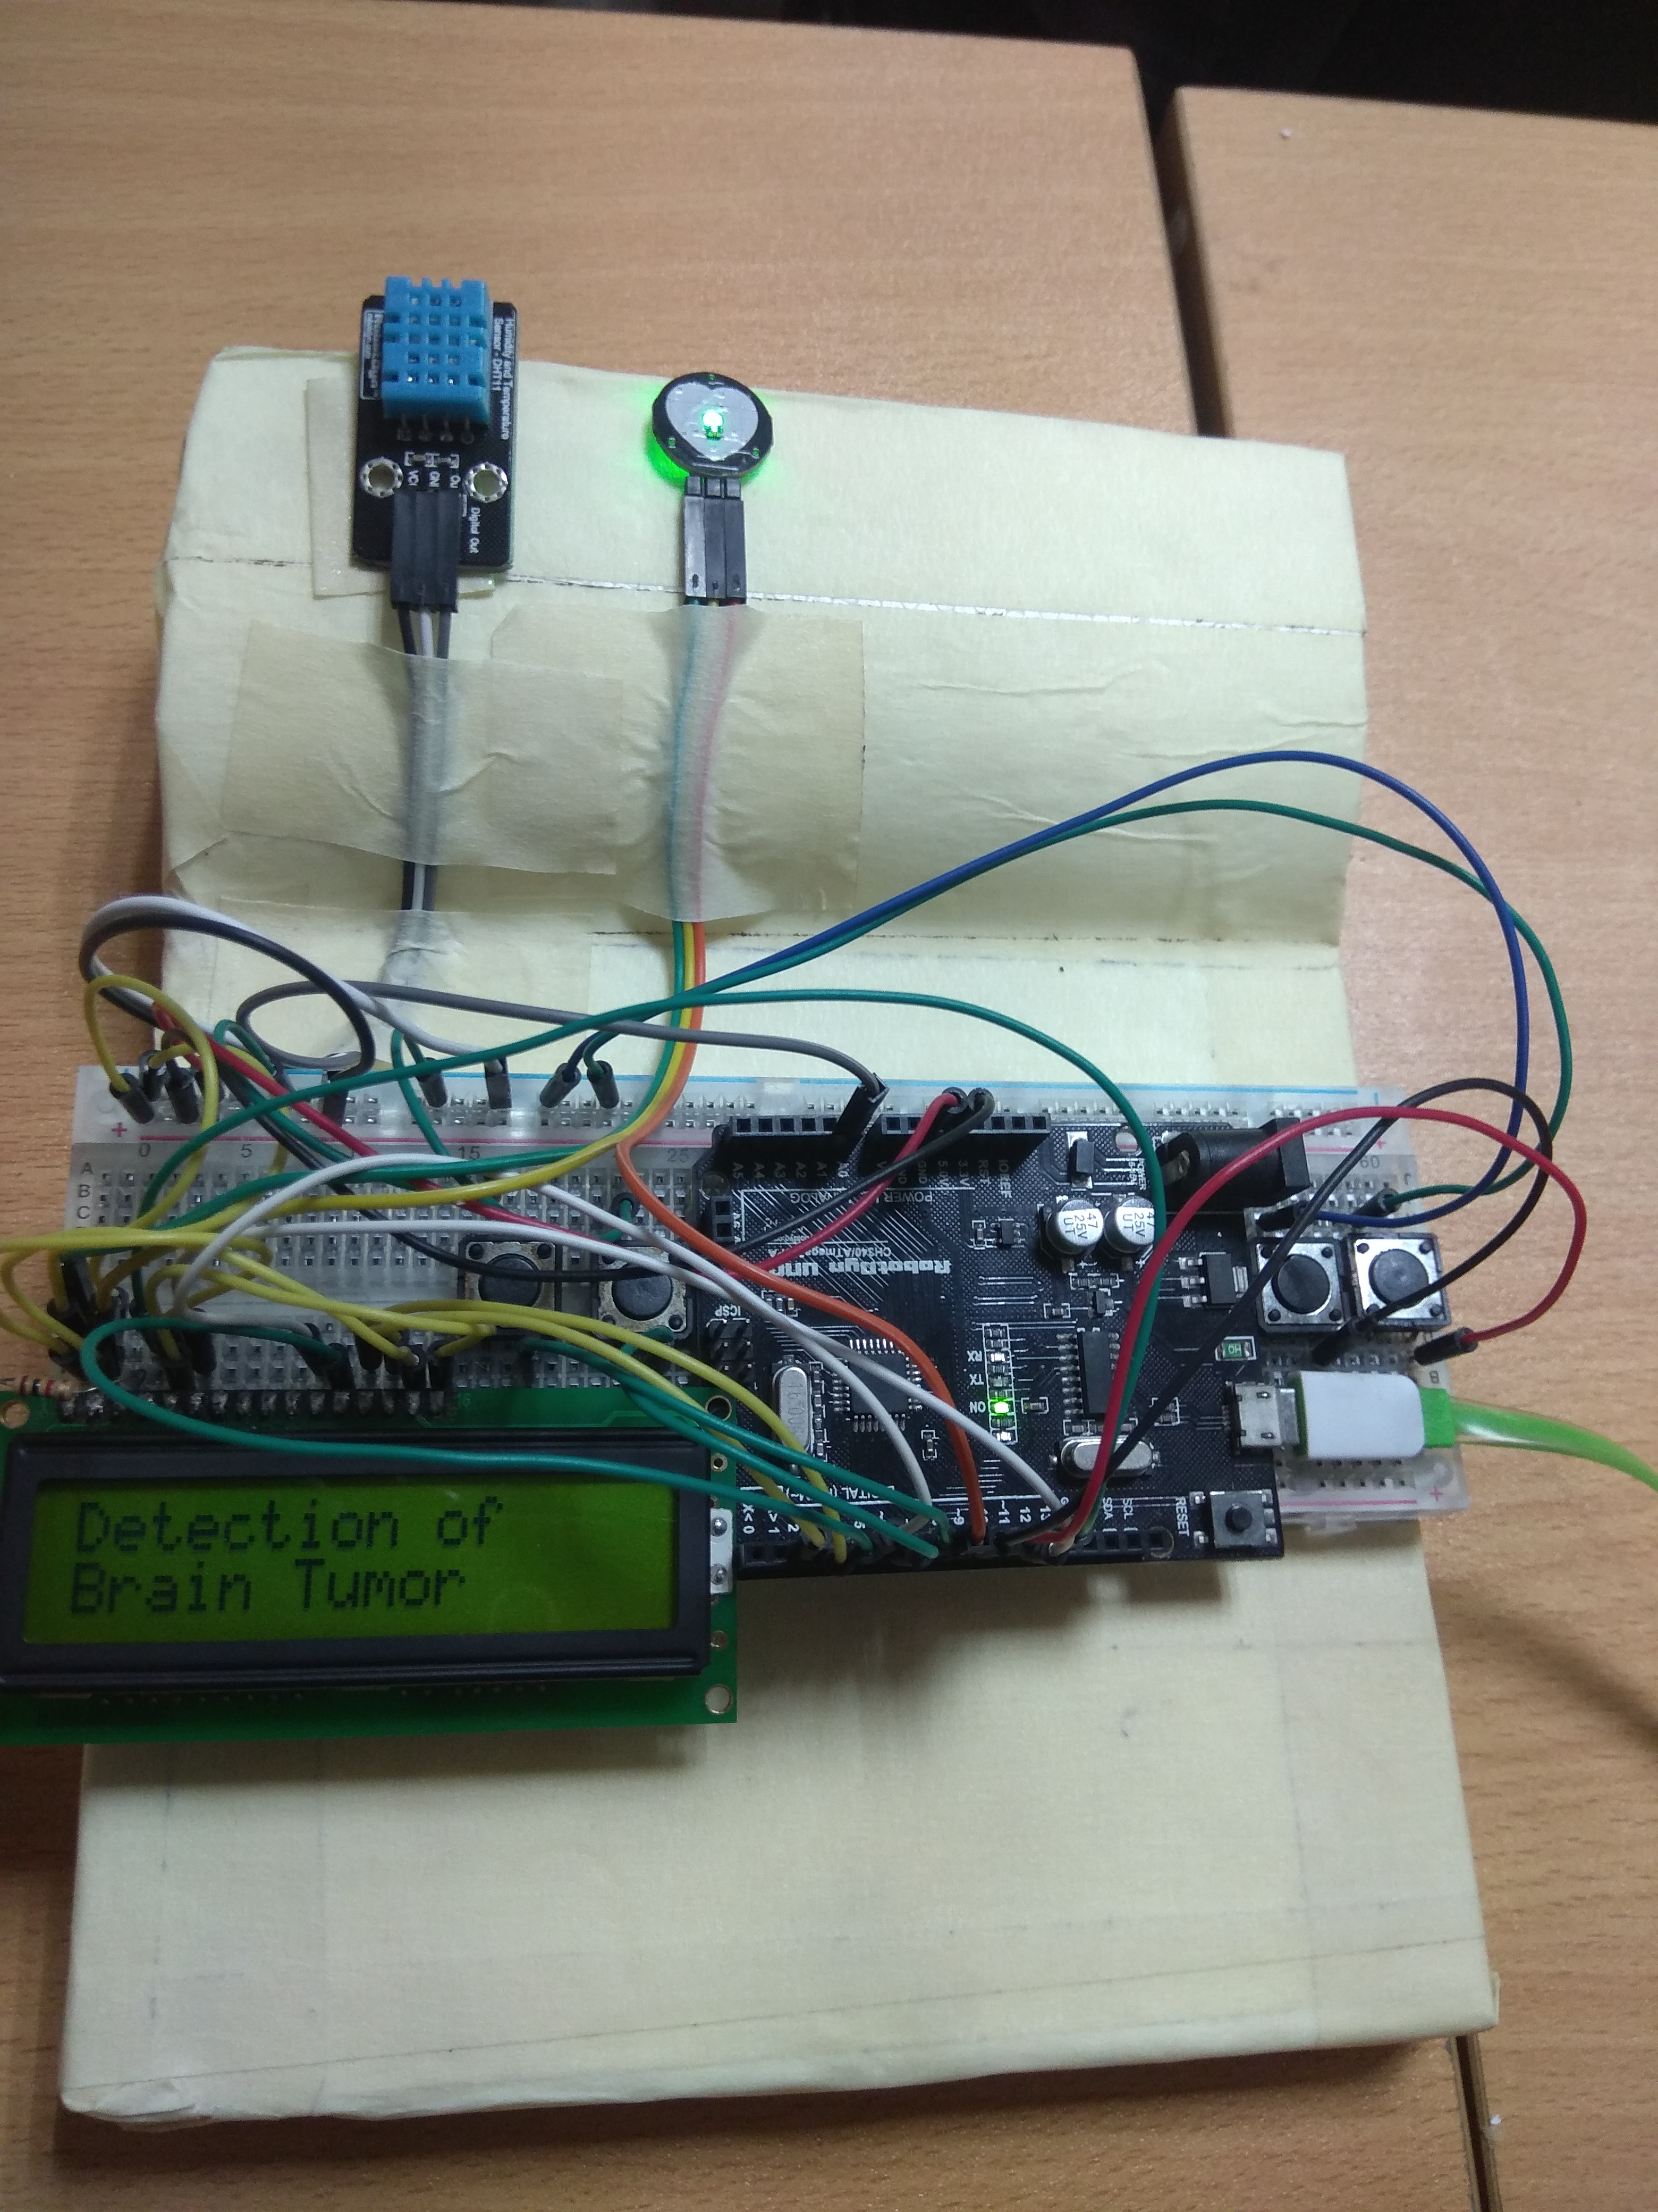
Experimental Scenario Device diagram
Temperature Sensor
Pulse Sensor
Lack Coordination in the arm or leg
Less amount of Steps
Start
Reset
12

Slide 13
Experimental Scenario overall process scenario
1
2
3
4
5
13

Slide 14
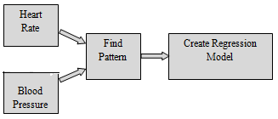
Experimental Scenario Blood Pressure Measurement
Category | Regression Model for SBP
Category 1 | Y= 0.383X + 108.222
Category 2 | Y= 0.2411X +106.27
Category 3 | Y= 0.2481X + 98.0867
Regression model equations for SBP
About 250+ data of Heart Rate and Blood Pressure are used to create these regression equations.
Category | Regression Model for DBP
Category 1 | Y= 0.03021X + 89.1288
Category 2 | Y= 0.0547X + 82.25
Category 3 | Y= 0.1231X + 69.23
14
Regression model equations for DBP

Slide 15
Experimental Scenario Blood Pressure Measurement Result analysis for Systolic Blood Pressure
SBP result analysis for Category 1
SBP result analysis for Category 2
SBP result analysis for Category 3
15

Slide 16
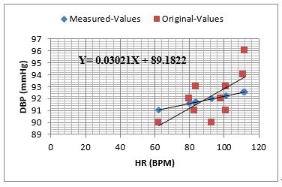
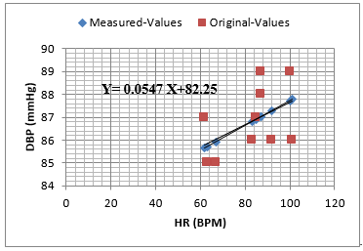
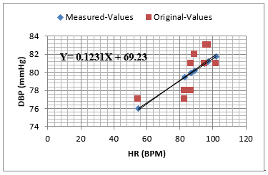
Experimental Scenario Blood Pressure Measurement Result analysis for Diastolic Blood Pressure
DBP result analysis for Category 1
DBP result analysis for Category 2
DBP result analysis for Category 3
16

Slide 17
Experimental Scenario Blood Pressure Measurement Result analysis for Diastolic Blood Pressure
In addition, we have shown the efficiency of our blood pressure measurement technique by comparing our method to [8].
We have used the same dataset which was used by [8], and observed that our method performs more accurately than [8].
Accuracy | Hassan et al. [8] | Our Method
Very Accurate | 35% | 80%
Slightly Inaccurate | 10% | 20%
Moderately Inaccurate | 10% | 0
Very Inaccurate | 45% | 0
Deference of Original & Measured Blood Pressure | Status
0 —2 mmHg | Very accurate
3 —4 mmHg | Slightly inaccurate
5 —6 mmHg | Moderately inaccurate
>6 mmHg | Very inaccurate
17
[8] Hassan, M.K.B.A., Mashor, M.Y., Nasir, N.M. and Mohamed, S., 2008. Measuring of systolic blood pressure based on heart rate. In 4th Kuala Lumpur International Conference on Biomedical Engineering 2008 (pp. 595-598). Springer, Berlin, Heidelberg

Slide 18
Experimental Scenario Deep Sleep Measurement
When a human enter into Deep Sleep, his/her heart rate and body temperature rapidly fall down.
During deep sleep a human heart rate decrease, and stay stable 50 bpm to 60 bpm range.
During deep sleep the body temperature of a human fall down below 97 degree Fahrenheit.
18

Slide 19
Result and discussion Scenario-1 (Brain Tumor Patients)
19

Slide 20
Result and discussion Scenario-2 (Normal Person)
20

Slide 21
Result and discussion
Percentage probability of brain tumor | Decision
70% or above | Brain Tumor
30% ≤%age probability<70% | Brain Tumor Candidate
Below 30% | Normal
Dataset | # of sample | Identify correctly
Scenario-1 ( Brain Tumor patient’s data) | 25 | 25
Scenario-2 (Normal person’s data) | 25 | 25
Decision table of Brain Tumor
Results of the proposed method
Brain Tumor Datasets
21

Slide 22
Research finding
Reference & Systems | Accuracy
Naïve Bayes Classifier [2] | 87.23%
Rao et al.[3] | 89%
Dandil et al.[10] | 90.79%
SVM classifier [2] | 91.49%
Samjit [7] | 95%
Proposed Method | 100%
Accuracy measure of different technique
22

Slide 23
Conclusion
If it is possible to detect any disease before it started to damage, the chance of recovery from diseases gets increase.
Our proposed brain tumor detection method does not require any magnetic resonance images (MRI), thus the computational complexity of our method is less as compare to other state-of-the-art techniques.
23

Slide 24
Future Works
In future we will make this project for automatic detection of brain tumor.
By adding other hardwires with our device, we will make it application based and portable.
24

Slide 25
Potential Applications
We can use our device in hospital to instant measure the possibility of Brain Tumor.
Our proposed method can be used in wrist wearable band, smart watch to find out the possibility of Brain Tumor.
25

Slide 26
List of Publications
“An IoT based Brain Tumor Technique”-to be submitted.
“Systolic Blood Pressure Measurement from Heart Rate Using IoT” Submitted, International Conference on Mathematics, Statistics and Scientific Computing (IMSSC-18).
26

Slide 27
Reference
[1] Islam, A., Reza, S.M. and Iftekharuddin, K.M., 2013. Multifractal texture estimation for detection and segmentation of brain tumors. IEEE transactions on biomedical engineering, 60(11), pp.3204- 3215.
[2] Singh, G. and Ansari, M.A., 2016, August. Efficient detection of brain tumor from MRIs using K- means segmentation and normalized histogram. In Information Processing (IICIP), 2016 1st India International Conference on (pp. 1-6). IEEE.
[3] Rao, C.H., Naganjaneyulu, P.V. and Prasad, K.S., 2017, January. Brain Tumor Detection and Segmentation Using Conditional Random Field. In Advance Computing Conference (IACC), 2017 IEEE 7th International (pp. 807-810). IEEE.
[4] Singh, B. and Aggarwal, P., 2017, October. Detection of brain tumor using modified mean-shift based fuzzy c-mean segmentation from MRI Images. In Information Technology, Electronics and Mobile Communication Conference (IEMCON), 2017 8th IEEE Annual (pp. 536-545). IEEE.
[5] Halder, A. and Dobe, O., 2017, September. Rough K-means and support vector machine based brain tumor detection. In Advances in Computing, Communications and Informatics (ICACCI), 2017 International Conference on (pp. 116-120). IEEE.
[6] S.K.Shil, F.P.Polly, M.A.Hossain, M.S.Ifthekhar, M.N.Uddin, and Y.M.Jang,2017, December. An improved brain tumor detection and classification mechanism. In Information and Communication Technology Convergence (ICTC),2017 International Conference. Doi:10.1109/ICTC.2017.8190941.
27

Slide 28
Reference
[7] C.P. Samjith Raj, R. Shreeja,2017.“Automatic brain tumor tissue detection in T-1 weighted MRI. I nternational Conference on Innovation in Information and Communication Systems (ICIIECS). IEEE
[8] Hassan, M.K.B.A., Mashor, M.Y., Nasir, N.M. and Mohamed, S., 2008. Measuring of systolic blood pressure based on heart rate. In 4th Kuala Lumpur International Conference on Biomedical Engineering 2008 (pp. 595-598). Springer, Berlin, Heidelberg
[9] El-Dahshan, E.-S.A., Mohsen, H.M., Revett, K., Salem, A.-B.M.: Computer-aided diagnosis of human brain tumor through MRI: a survey and a new algorithm. Expert Syst. Appl. 41, 5526–5545 (2014)
[10] E. Dandil, M. Cakiroglu, Z. Eksi, “Computer-aided diagnosis of malign and benign brain tumors on MR images,” ICT Innovation 2014, pp. 157-166, 2015.
[11] C. L. Devasena and M. Hemalatha, “Efficient computer aided diagnosis of abnormal parts detection in magnetic resonance images using hybrid abnormality detection algorithm,” Central European Journal of Computer Science, Vol. 3, no. 3, pp. 117-128,2013.
[12] M. P. Arakeri and G. R. M. Reddy, “computer-aided diagnosis system for tissue characterization of brain tumor on magnetic resonance images,” Signal Image and Video Processing, vol. 9, no. 2, pp. 409-425, 2015.
[13] National Institute of Cancer Research & Hospital (NICRH) Mohakhali, Dhaka-1212
https://National+Institute+of+Cancer+Research+%26+Hospital+Mohakhali%2C+Dhaka-1212
Website: nicrh.dghs.gov.bdM
28

Slide 29
Q & A?

